Slide 1

Assignment 2
Object Oriented Programming
Fall 2020
Seon Joo Kim
Yonsei University
1

Slide 2
Outline
Deadline
No Plagiarism
Leave Comments
Scoring
Problem 1
Problem 2
Problem 3
Problem 4
Submission
Questions

Slide 3
Deadline
Tuesday, October 6th 23:55
No late submissions at all

Slide 4
No Plagiarism
No Mercy.
The punishment will be made to both
  the person who copied the code, and the person who shared the code.
We will do plagiarism test with codes that were made in previous semesters and also in google. So be careful ☺

Slide 5
Leave Comments
Leave comments in your file for TAs to understand your code.
If no comments in the file, there may be a reduction of points.

Slide 6
Scoring
You should take care of your code not terminating by an issue in the middle of the loop
  Scores will be given only by the final outputted file
Example
  5 test cases
  If your code is correct as O X O O O if ran seperately
  but terminates in the second test case by an error
  only the first test case is considered correct
Problem1 (15%) Problem2 (25%)
Problem3 (30%) Problem4 (30%)
If your code outputs correctly for given example input#.txt file
  30% base score per problem
There will be additional 20 test cases
  (70 / 20) = 3.5% per each case

Slide 7
Scoring
When ran the code, the printed text (by cout) in the terminal can be recorded in a file by ‘>>’ command
We will score the results by saving your programs printed texts by ‘>>’, and compare by ’diff’ command
problem1 ~ problem4 will be graded in this way.
Example
  $ g++ -Wall problem1.cpp –o problem1
  $ ./problem1 >> output1.txt
  $ diff answer.txt output1.txt

Slide 8
Problem 1
Write a program that reads an array of characters in English and counts how many vowels are included.
You have to use arrays to save input and counts of vowels.

Slide 9
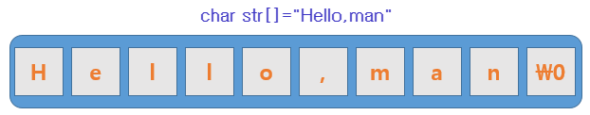
Problem 1
Since we have not yet learned much about c++ string, I’ll give you a hint.
1. ‘\0’(null character) is a special character that automatically attaches to the end of a string.
2. you could use cstring library to handle string in c++. Ex. strlen
Instruction
  Input
    First row of input is number of loops : N
    From the second row, each line contains array of characters.
    Assume that there is no input more than 50 characters.
    No error case for this input, so don’t need to handle exception for this input.
    Only small letter alphabets and space are allowed for input. (Do not care about capital letter)
  Output
    Each line contains the number of occurrences of each vowel in a, e, i, o, u order (alphabetic order).
I/O example
added on 200924
Input (input1.txt) | Output
3 hello world yonsei university object oriented programming | 0 1 0 2 0 0 2 3 1 1 1 3 2 3 0
a:0 e:1 i:0 o:2 u:0
a:0 e:2 i:3 o:1 u:1
→ a:1 e:3 i:2 o:3 u:0

Slide 10
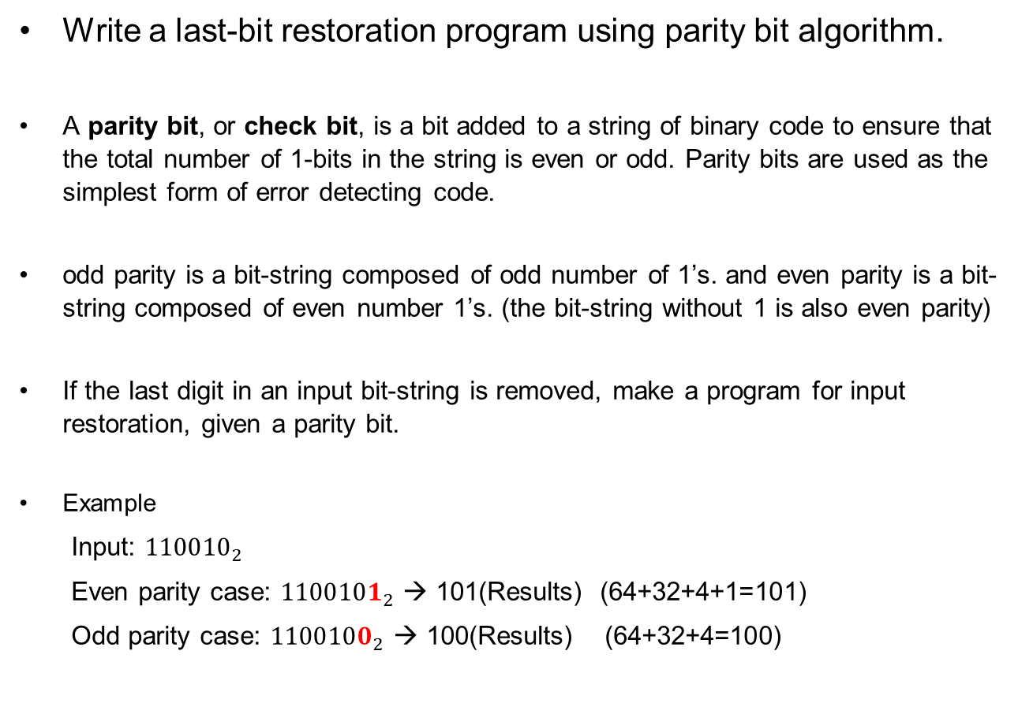
Problem 2
Write a last-bit restoration program using parity bit algorithm.
A parity bit, or check bit, is a bit added to a string of binary code to ensure that the total number of 1-bits in the string is even or odd. Parity bits are used as the simplest form of error detecting code.
odd parity is a bit-string composed of odd number of 1’s. and even parity is a bit-string composed of even number 1’s. (the bit-string without 1 is also even parity)
If the last digit in an input bit-string is removed, make a program for input restoration, given a parity bit.
Example
  Input: ${110010}_{2}$
  Even parity case: ${1100101}_{2}$ → 101(Results) (64+32+4+1=101)
  Odd parity case: ${1100100}_{2}$ → 100(Results) (64+32+4=100)
need 1 to be even parity case

Slide 11
Problem 2
Instruction
  Input
    First row of input is number of loops : N
    From the second row, each line contains information for parity restoration.
    binary number length (space) Binary number (space) Even parity: e, odd parity: o
    binary number length: 0 < x < 50, # There are ‘spaces’ between binary number digits.
  Output
    Each line contains restored input which is converted to decimal.
I/O example
Input (input2.txt) | Output
4 6 1 1 0 0 1 0 e 6 1 1 0 0 1 0 o 3 1 1 1 e 1 0 e | 101 100 15 0

Slide 12
Problem 3
Write a program for Bigger is better game
Instruction for Bigger is better
  This is a simple game. There are 2 players(A, B) in this game, and they are given N cards when the game started. They have to open the cards in order where they are given. When they open their cards, they compare them and one who has a bigger card becomes the winner. Loser’s card is discarded, and winner’s card is degraded by the difference of cards. If the cards’ number is the same, they draw(no winner), and the cards of both of the players are discarded. The winner of each ground takes 1 pts, and the game is over if one player has no card more. The simulation of the game is introduced on the next slide.

Slide 13
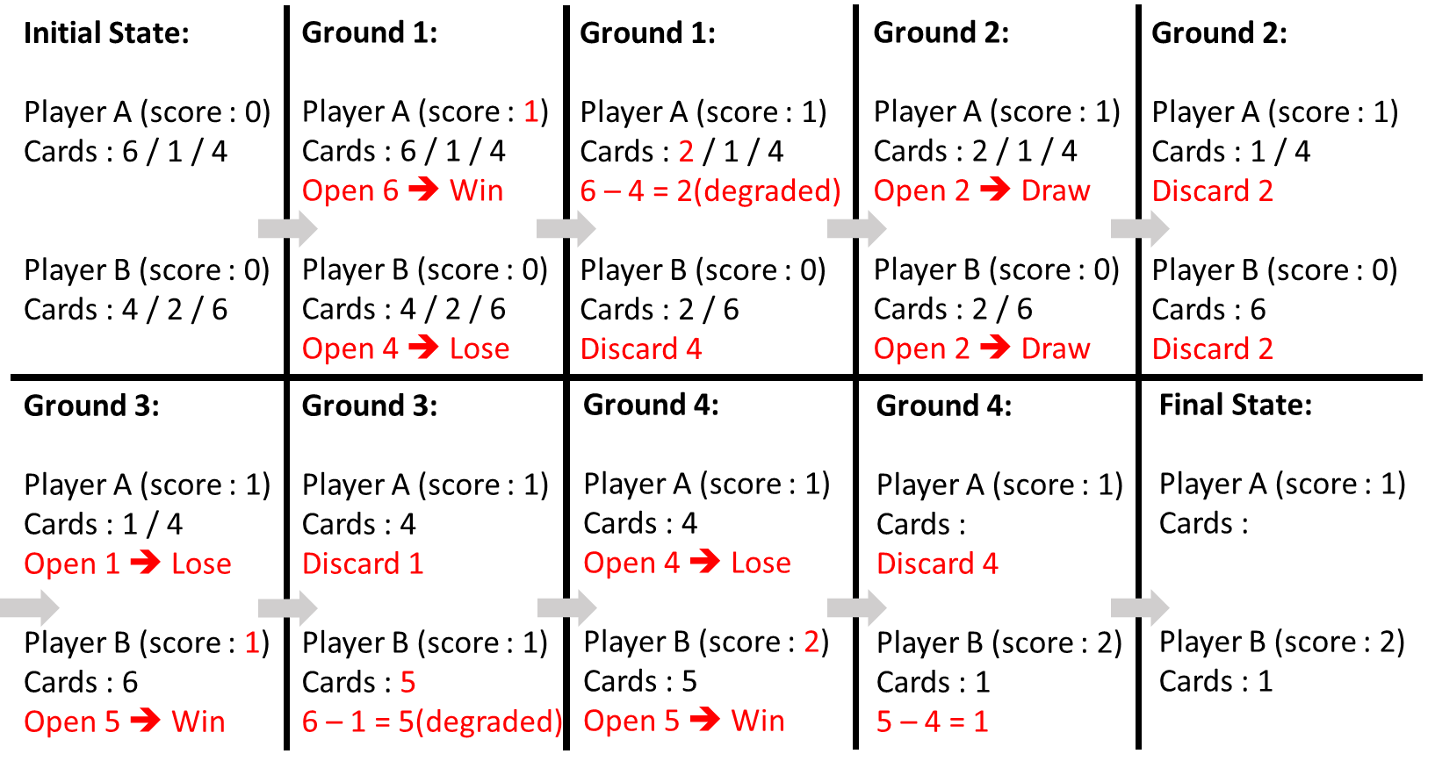
Problem 3
<Example>

Slide 14
Problem 3
Instruction
  Input
    First row of input is number of loops : N
    From the second row, each three line contains information for bigger is better game.
    The number of cards (K) is given in the first row (1 ≤ K ≤ 1000)
    K card number (c) streams in the next 2 rows (0 ≤ c ≤ 10000) – always integer
  Output
    Each line contains scores of each player in each game
    output format → player1’s_score (space) player2’s_score
I/O example
Input (input3.txt) | Output
3 3 6 1 4 4 2 6 5 9 10 6 12 7 6 1 5 11 20 7 10 2 9 33 17 5 21 6 19 33 18 3 0 11 | 1 2 5 4 6 5

Slide 15
Problem 4
Write a program for airline reservation system.
  tip : Call-by-reference practice
Our system should provide these two features.
  add passenger
  delete passenger
There are three types of seats and each type has different number of seats.
  first class (total seats: 5)
  business class (total seats: 25)
  economy class ((total seats: 50)
At first, all flight seats are vacant.

Slide 16
Problem 4
1. add passenger (use void add_passenger)
Instruction
  Function to reserve seats
  If the number of seats to be reserved is more than limit, the number of passengers remains unchanged and print “full seat”
  If adding passenger is complete, print “add complete”

Slide 17
Problem 4
2. delete passenger (use void delete_passenger)
Instruction
  Function to cancel reservation
  If the number of seats to be deleted is less than reserved seat, the number of passengers remains unchanged and print “wrong input”
  If adding passenger is complete, print “delete complete”
revised on 200924
more

Slide 18
Problem 4
3. show seat state (use void print_seat_state)
Instruction
  Function to show availability map and number of remaining seats
  Seat available: O (capital O), unavailable: X (capital X)
Examples
OOOOO
OOOOO
economy class
OOOOO
OOOOO
OOOOO
OOOOO
OOOOO
OOOOO
OOOOO
OOOOO
OOOOO
OOOOO
OOOOO
OOOOO
economy class
XXXXX
XXXXX
XXXXX
XXXXX
XXXXX
XXXXX
XXXXX
XXXXX
XXXXX
XXXXX
current vacant seats
first class: 5/5
business class: 25/25
economy class: 50/50
first class
OOOOO
business class
OOOOO
OOOOO
OOOOO
current vacant seats
first class: 2/5
business class: 15/25
economy class: 0/50
first class
XXXOO
business class
XXXXX
XXXXX
OOOOO

Slide 19
Problem 4
Instruction
  Input
    First row of input is number of function calls : N
    From the second row, each line contains information of two types of features
    feature_type (space) seat_type (space) number_of_passengers
  Output
    Cout when each event occurs, and when function calls are end, print current passenger state.
feature type
1 → add_passenger
2 → delete_passenger
seat type
1 → first class
2 → business class
3 → economy class
do not consider about other inputs
Ex.
feature_type = 3
seat_type = 4
added on 200924

Slide 20
Problem 4
I/O example.
Input (input4.txt) | Output
5 1 1 3 1 3 55 1 2 25 2 3 30 2 2 11 | add complete full seat add complete wrong input delete complete current vacant seats first class: 2/5 business class: 11/25 economy class: 50/50 first class XXXOO business class XXXXX XXXXX XXXXO OOOOO OOOOO economy class OOOOO (1) | OOOOO OOOOO OOOOO OOOOO OOOOO OOOOO OOOOO OOOOO OOOOO end the program (2)
(2/5) (25/25) (50/50)
(2/5) (25/25) (50/50)
(2/5) (0/25) (50/50)
(2/5) (0/25) (50/50)
(2/5) (11/25) (50/50)

Slide 21
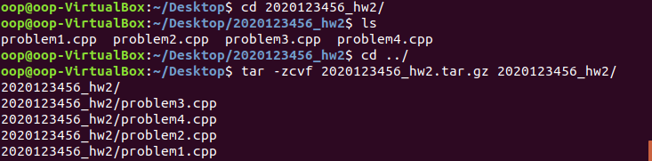
Submission
Zip the folder by following steps correctly
studentId_hw2.tar.gz
  Ex) 2020123456_hw2.tar.gz
There is going to be reduction of points if not following the folder hierarchy as well
If unzipped your submission .tar.gz file should follow the folder hierarchy below
Current directory
  - studentId_hw2.tar.gz
  - studentId_hw2
  - problem1.cpp
  - problem2.cpp
  - problem3.cpp
  - problem4.cpp

Slide 22
Questions
Use oop20202@gmail.com for questions
We are not going to answer
  Questions sent to TAs’ personal mails
  Questions not making sense
  Questions related to the algorithm for solving the question
  Questions you can infer the answer if read this file thoroughly
  Questions you can simply solve by googling
    Ex) how do I make a folder on ubuntu?

Slide 23
Appendix
File I/O
#include <fstream>
ofstream outfile;
outfile << "Hello, World!\n"; // writing Hello,World! into the file
outfile.close(); // should close the file before terminating the process
ifstream infile("input.txt");
infile >> number; // reading the first digit written in input.txt
infile.close(); // should close the file before terminating the process
https://stackoverflow.com/questions/7868936/read-file-line-by-line-using-ifstream-in-c

Slide 24
Appendix
Zipping and unzipping the folder by tar command
  https://linuxize.com/post/how-to-extract-unzip-tar-gz-file/
  https://www.cyberciti.biz/faq/how-do-i-compress-a-whole-linux-or-unix-directory/

